Slide 1
Housing Project:
Predicting Housing Sale price in Australia
Submitted by:- Rakesh Chaudhary
April 2022

Slide 2
Introduction:-
A house is usually the single largest purchase an individual will make in their lifetime. Such significant purchase warrants being well-informed about what a house’s selling price should be; for the buyer, as well as the seller or real estate broker involved. The power of machine learning provides us with the tools we need to look at a large data set and spit out a predicted value, which was our main goal in this project. Using a dataset containing information on houses in Ames, Iowa, our team leveraged different machine learning techniques to predict sale prices based on both practical intuition and those observed through our exploratory data analysis and model fitting processes.
The general outline of the process was:
Imputing Missing Values
Exploratory Data Analysis
Feature Engineering/Dimension Reduction
Fixing Skewness and Outliers
Modeling

Slide 3
Problem Statement:-
AUS-based housing company named Surprise Housing has decided to enter the Australian market. The company uses data analytics to purchase houses at a price below their actual values and flip them on at a higher price. For the same purpose, the company has collected a data set from the sale of houses in Australia.
The company is looking at prospective properties to buy to enter the market. You are required to build a regression model using regularization in order to predict the actual value of the prospective properties and decide whether to invest in them or not.
Goal You are required to model the price of houses with the available independent variables. This model will then be used by the management to understand how exactly the prices vary with the variables. They can accordingly manipulate the strategy of the firm and concentrate on areas that will yield high returns.

Slide 4
Data Exploration

Slide 5
The Purpose is to Predict Housing Price with Least Error
We trained 10 Models, which are proven to be effective, to predict prices based on Housing information
Over 80 Input variables:
Information about Houses
Lasso Regression
Ridge Regression
Linear Regression
Output Or Target:-
Housing Sales Price
Overall Quality
Above- Grade Living Area
Size of garage in Square Feet
Random Forest Regressor
Gradient Boosting
XGB Regressor
Original construction Date
Neighbourhood
Lot size in square feet
Stack Regressor
RMSE: Root Mean Square Error

Slide 6
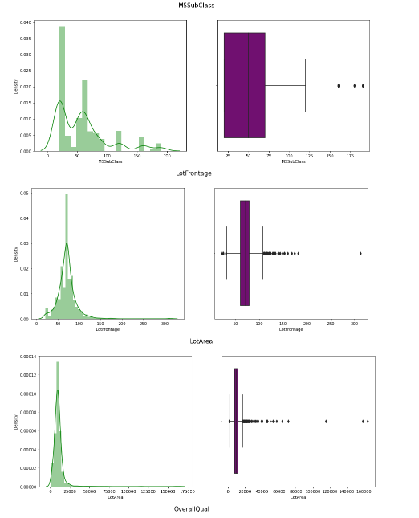
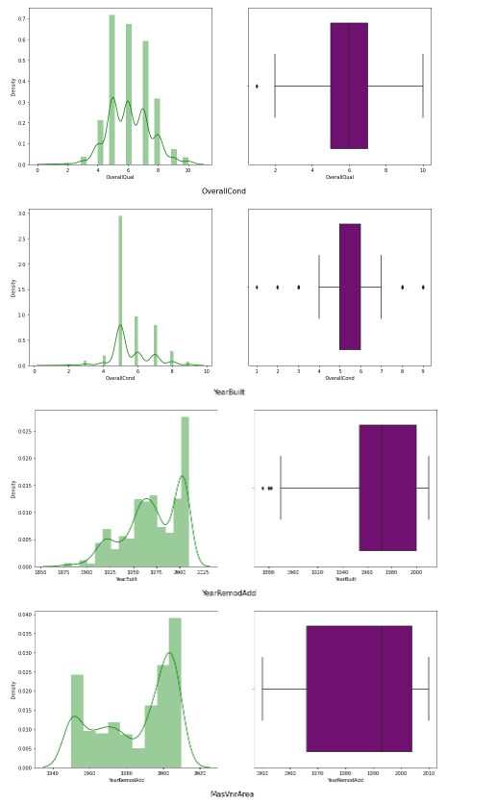
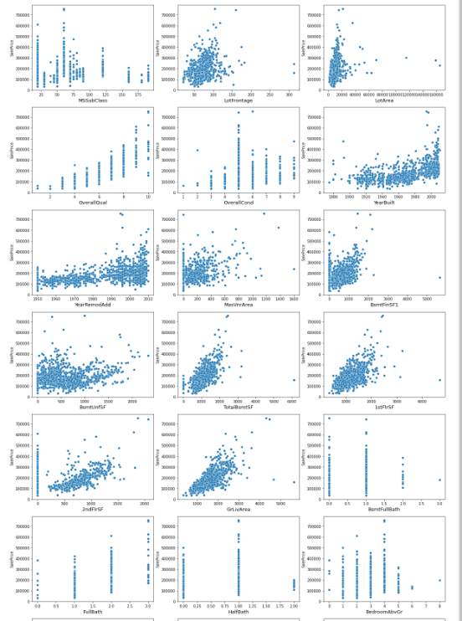
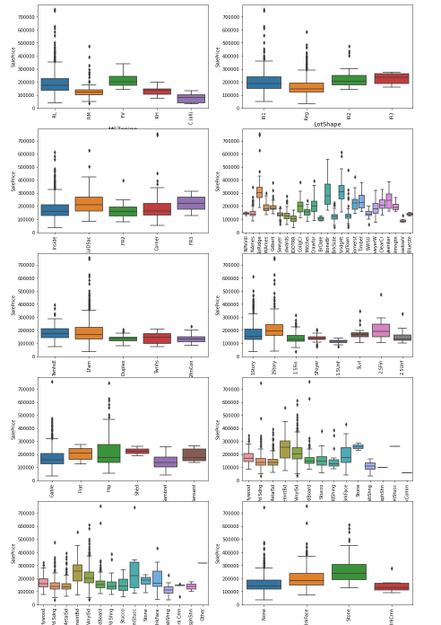
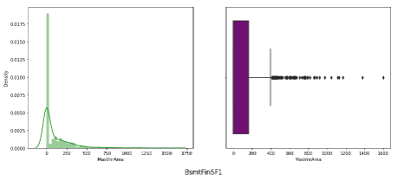
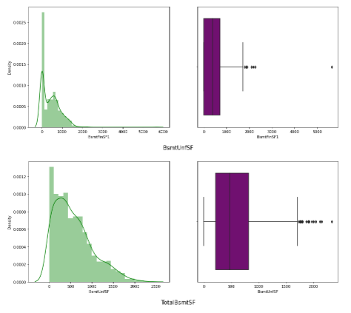
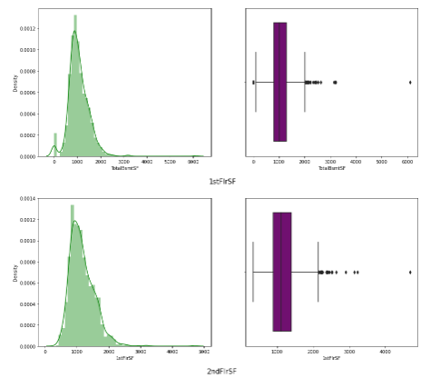
A Glance of Dataset:
Exploration dataset is the foundation of the following pre-processing and modelling:
Distribution of variables
Relationship Between Numerical inputs and Target
Relationship Between categorical inputs and Target

Slide 7
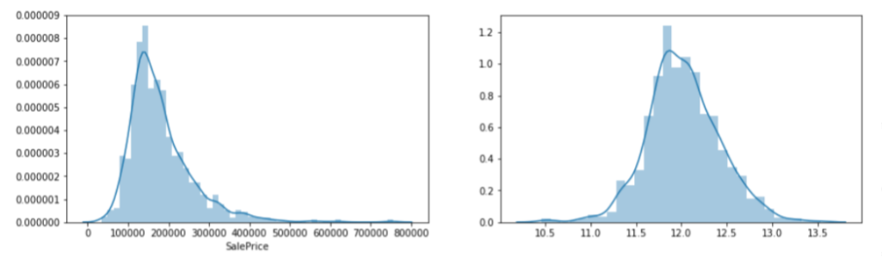
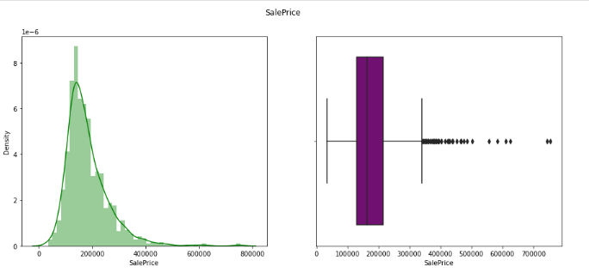
Visualizations:-
Target Variable
Let's start with the distribution of the target variable, sales price. There is a clear right-skew in the distribution of sale price with a vast majority of property values in the $100,000 — $200,000 range, but with a long tail stretching upward towards $800,000 (bottom left image). Using a Box-Cox transformation, we identified that taking the log of sale price transforms the distribution to approximately normal (bottom right image). This transformation increased the strength of linearity amongst most of our variables against sale price, validating the assumption of linearity in regression.

Slide 8
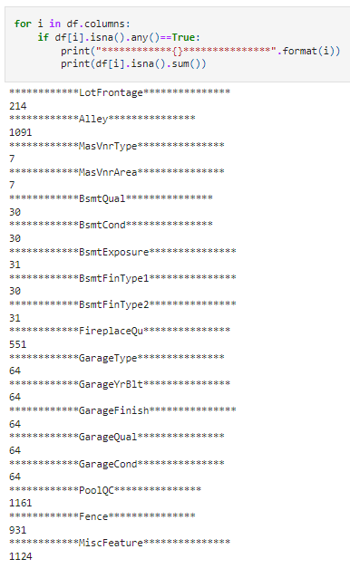
Handling Missing Values:-
Imputing Missing Values:-
lot frontage: Since the area of each street connected to the house property most likely have a similar area to other houses in its neighborhood, we can fill in missing values by the median Lot Frontage of the neighborhood.
GarageType, GarageFinish, GarageQual, and GarageCond: Replacing missing data with “None”.
GarageYrBlt, GarageArea, and GarageCars: Replacing missing data with 0.
BsmtFinSF1, BsmtFinSF2, BsmtUnfSF, TotalBsmtSF, BsmtFullBath and BsmtHalfBath: Replacing missing data with 0.
Dataset
Missing
Value
BsmtQual, BsmtCond, BsmtExposure, BsmtFinType1, and BsmtFinType2: For all these categorical basement-related features, NaN means that there isn’t a basement.
MasVnrArea and MasVnrType: NA most likely means no masonry veneer for these houses. We can fill 0 for the area and None for the type.
MSZoning (The general zoning classification): ‘RL’ is by far the most common value. So we can fill in missing values with ‘RL’.
Utilities: For this categorical feature all records are “AllPub”, except for one “NoSeWa” and 2 NA. Since the house with ‘NoSewa’ is in the training set, this feature won’t help in predictive modeling. We can then safely remove it.
Exterior1st and Exterior2nd: Both Exterior 1 & 2 have only one missing value. We will just substitute in the most common string.
MSSubClass: Na most likely means No building class. We can replace missing values with None

Slide 9
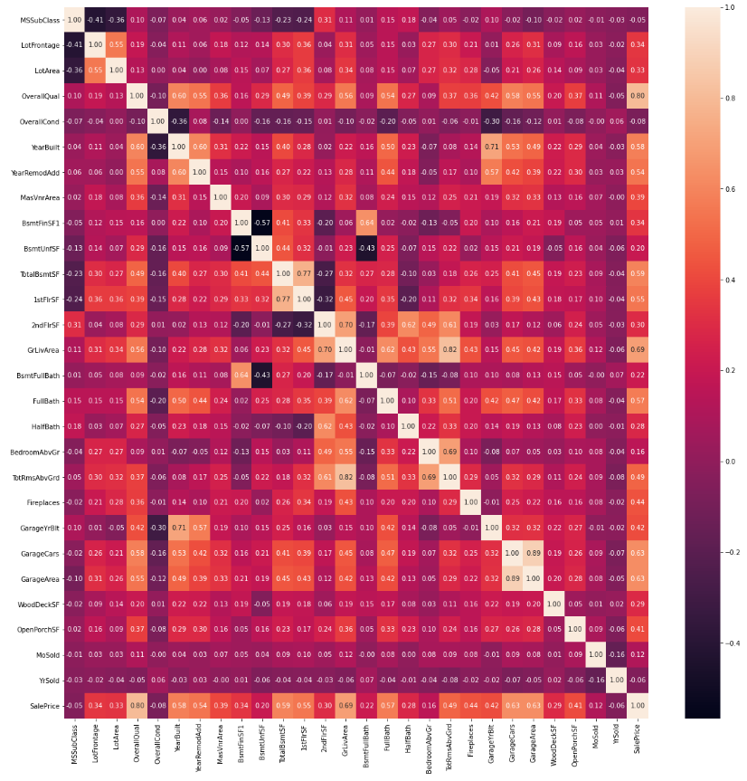
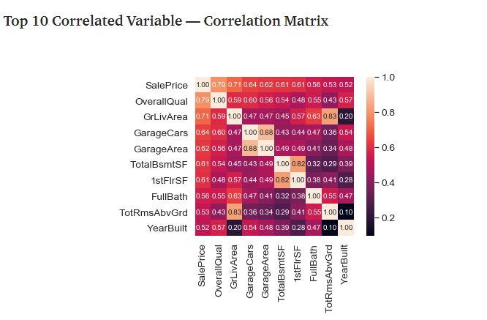
Heat Map:-
##Observation:-
GarageCars and GarageArea is highly correlated with each other. Typically we can say that our data set have multicollinearity problem. And also both are equally correlate with target variable.
GLivArea and TotRmsAbvGrd features are also highly correlate with each other with 80% correlation.
1stFlrSF and 2ndFlrSF features are also correalte with each other with 77% correlation.

Slide 10
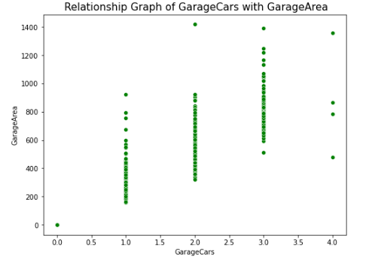
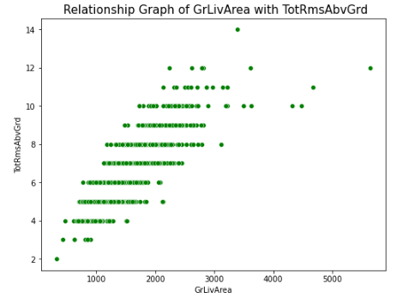
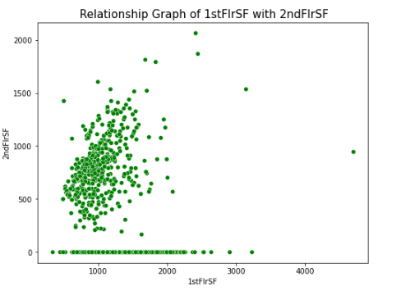
Checking Multicollinearity:-
Observations:-
As we assume, all of them showing tight relation with eachother, so we have to drop any 1 feature from every pair.
GarageCars and GarageArea both are equally correlate with target variable. So we can drop any of them.
GrLivArea and TotRmsAbvGrd are correalted with target variable as 69% and 49% respectively. So we will drop TotRmsAbvGrd feature as it is less correlate with target with compare to GrLiveArea.
1stFlrSF and 2ndFlrSF are correalted with target variable as 55% and 30% respectively. So we will drop 2ndFlrSF feature as it is less correlate with target with compare to 1stFlrSF.

Slide 11
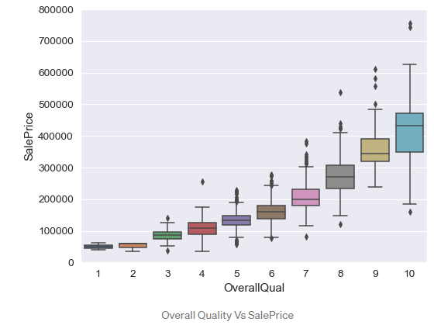
Overall Quality Vs Sale Price
Observation -
The plot defines we can state that as OverallQual increases, the SalePrice also increases.
The above assumption is true on normal assumption also, As OverallQual is more the SalePrice is also more.

Slide 12
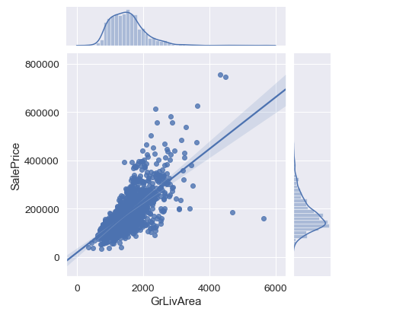
GrLivArea Vs SalePrice:
Observation –
People pay more for more living area.
In the above plot, there is a value which has the least cost for more living area. It is better to remove it
GrLivArea seems outside the range of 4000 to 200000 appears to be an outlier. In the below plot we can see the variable after removing outlier.

Slide 13
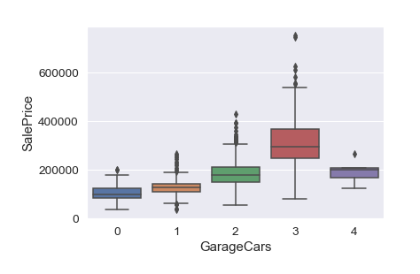
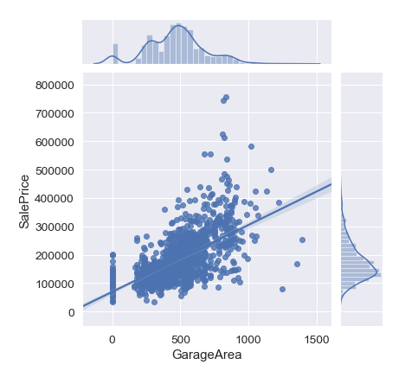
GarageCars Vs SalePrice
Observation:-
From the above plot we can say that for GarageCars of 3, the SalePrice is more.
But strange is that the GarageCars==4 having less cost, As it is an outlier we can remove this outlier
GarageArea Vs SalePrice
Observation:-
From the above plot, we can say that for GarageArea of 200–1000 has most of the SalePrice.
But strange is that the GarageArea>=1000 having less cost, As it is an outlier we can remove this outlier

Slide 14
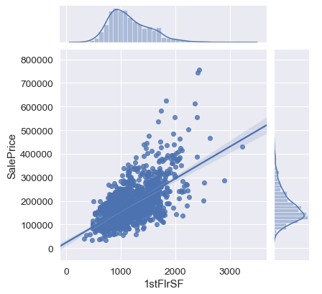
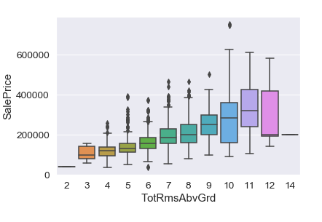
1stFlrSF Vs SalePrice
Observation:-
From the above plot, we can say that for 1stFirSF of 500–2000 has most of the SalePrice.
We can see as 1st-floor square feet increases, the SalePrice also increases
TotRmsAbvGrd Vs SalePrice
Observation:-
From the above plot, we can say that for TotRmsAbvGrd having more than 11 rows has less weight.
May be those are old enough due to which they cost less, But it is just an assumption.

Slide 15
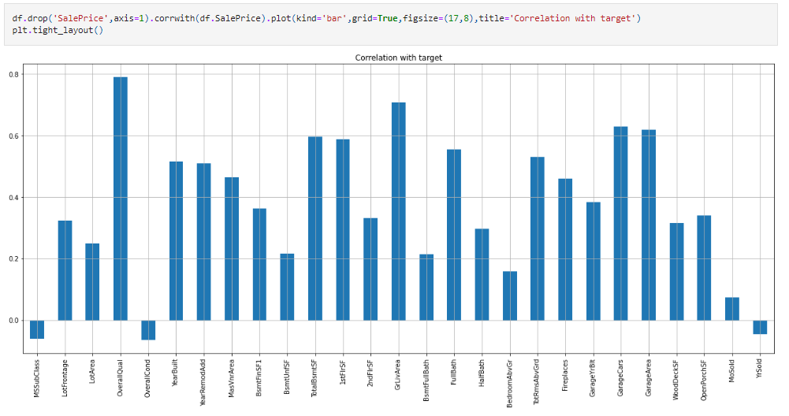
Correlation With Target:-
Observations:-
MSSubClass, OverallCond, YrSold feature are negative correlated with target and in other hand all the features are positive correlated with the target variable.
Overallcond feature is showing highest correlation with target variable.
MoSold feature is showing least correlation with target variable.

Slide 16
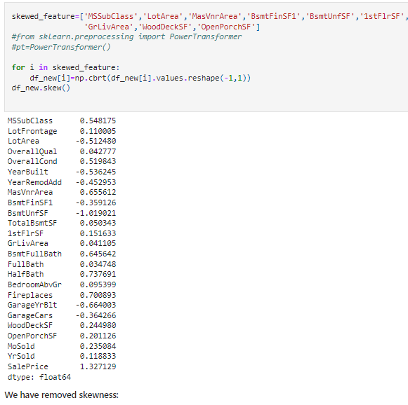
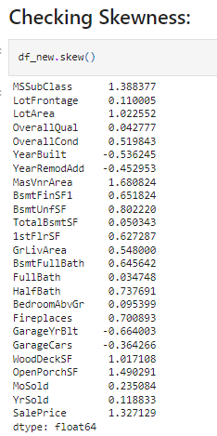
Checking And Handling Skewness
Handling Skewness

Slide 17
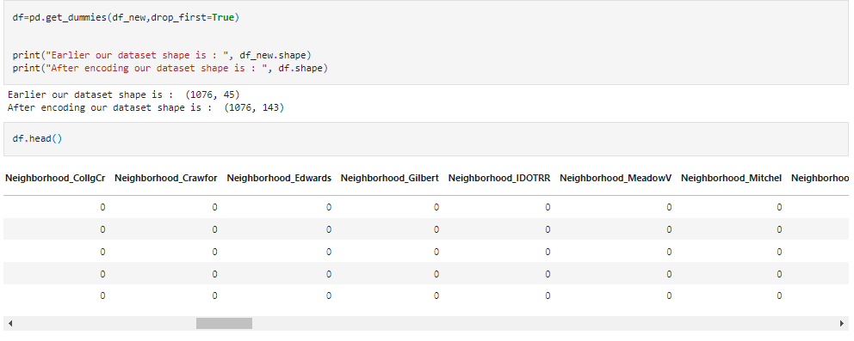
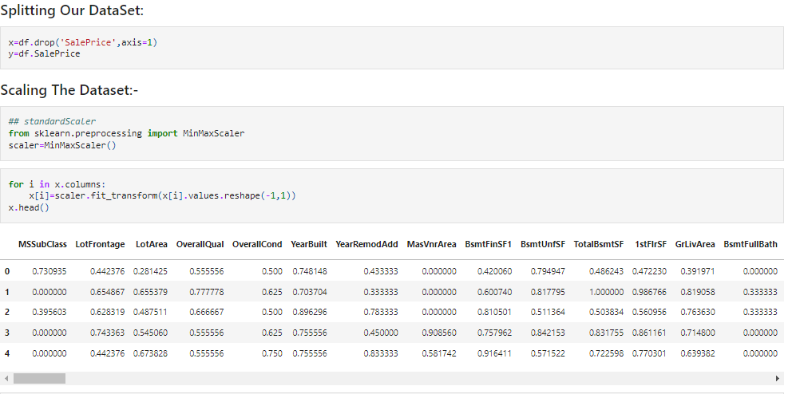
Encoding & Scaling

Slide 18
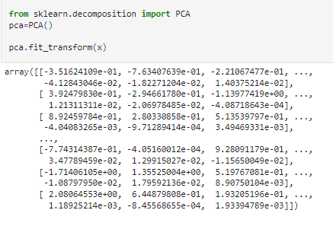
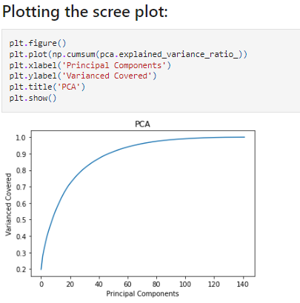
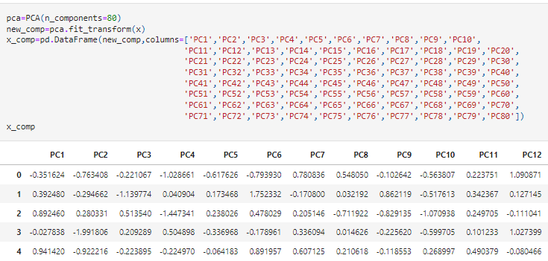
PCA (Principal Component Analysis)
Working:- Principal component analysis, or PCA, is a statistical procedure that allows you to summarize the information content in large data tables by means of a smaller set of “summary indices” that can be more easily visualized and analyzed.
Step One
Step Two
Step Three

Slide 19
Models Used for Predicting Sale Price
Linear Regression()
Lasso()
Ridge()
Decision Tree Regressor()
Kneighbors Regressor()
SVR()
XGB Regressor()
Random Forest Regressor()
Ada Boost Regressor()
Gradient Boosting Regressor()
Performing Very Well
Not Performing Well.

Slide 20
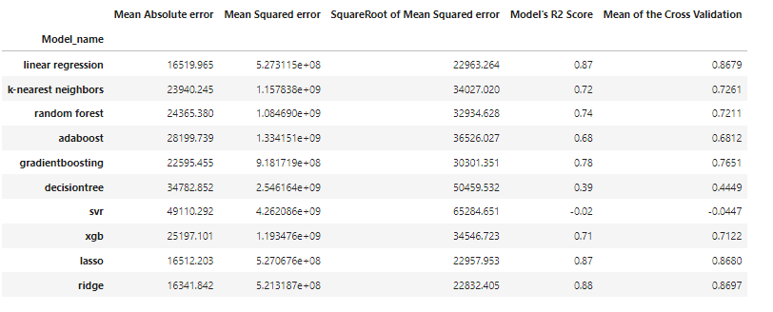
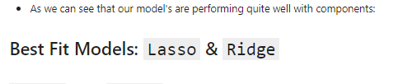
Model's Score With Cross Validation:

Slide 21
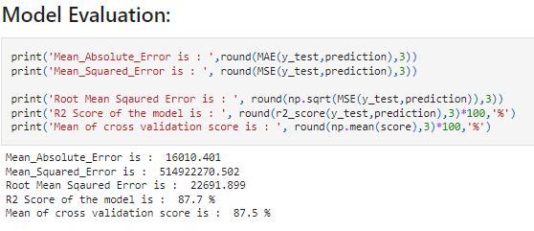
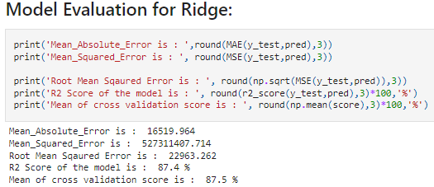
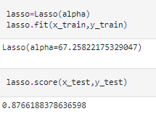
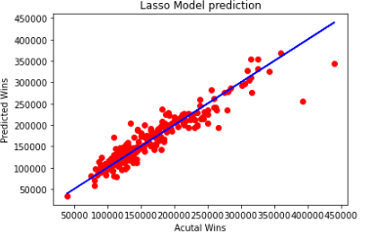
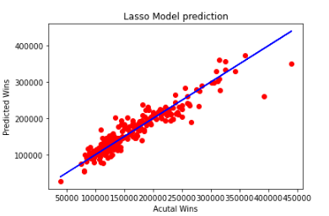
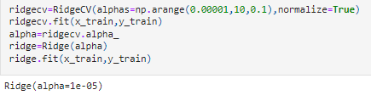
HyperParameter Tunning and Model Evaluation
Lasso
Ridge
Finding Best Alpha Rate
Visualize the Lasso model
Finding Best Alpha Rate
Visualize the Ridge model

Slide 22
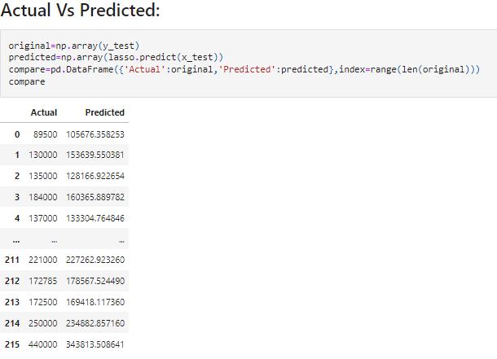
Actual VS Predicted
A difference between the predicted regression value and the actual value is called residual. One of the main assumptions of the regression analysis is the normal distribution of the residuals with the mean equal to 0, i.e residuals must be both positive and negative.

Slide 23
Conclusion:-
In this research paper, we have used machine learning algorithms to predict the house prices. We have mentioned the step by step procedure to analyze the dataset and finding the correlation between the parameters. Thus we can select the parameters which are not correlated to each other and are independent in nature. These feature set were then given as an input to four algorithms and a csv file was generated consisting of predicted house prices.
From the above two techniques of Lasso and Ridge Regression, we can say that both almost having the same r2 value.
When comparing the complexity, it is better to use Lasso because as we have 221 variables, Lasso will make the feature selection among the present variables, but Ridge will not reduce columns, it will keep all 221 variables with the reducing the coefficient of variables.
OverallQual is highly correlated column with target variable followed by GrLivArea and other attributes.

Slide 24
Future Work:-
For future work, we recommend that working on large dataset would yield a better and real picture about the model. We have undertaken only few Machine Learning algorithms that are actually classifiers but we need to train many other classifiers and understand their predicting behavior for continuous values too. By improving the error values this research work can be useful for development of applications for various respective cities.

Slide 25
Thank You…!!!
Rakesh Chaudhary
E-Mail:- rc93619@gmail.com
Git-hub_ID:- rakesh93619

